Slide 1

Deep Learning with Keras
Basic of Neural Network

Slide 2
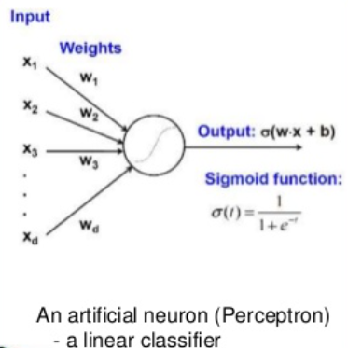
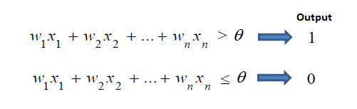
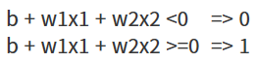
perceptron

Slide 3
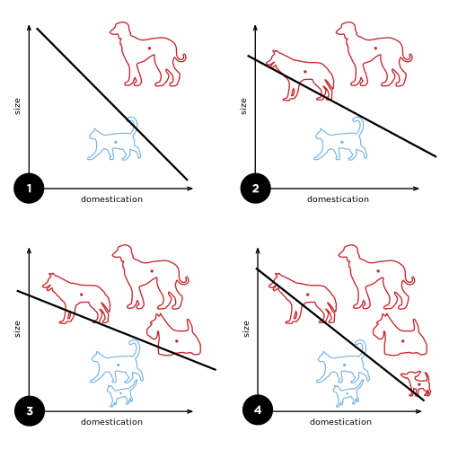
If data was appended
Weight and Bias must be adjust

Slide 4
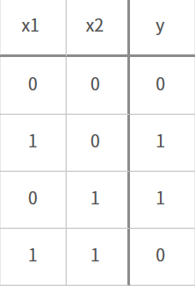
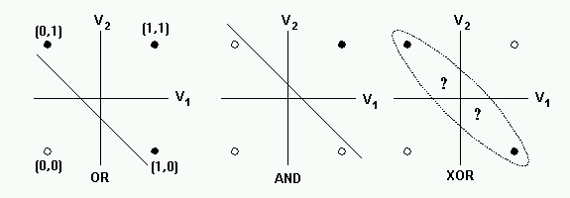
Limitation for linear classifier

Slide 5
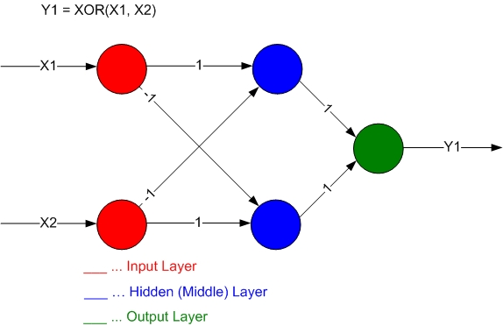
How fix it’s trouble?

Slide 6
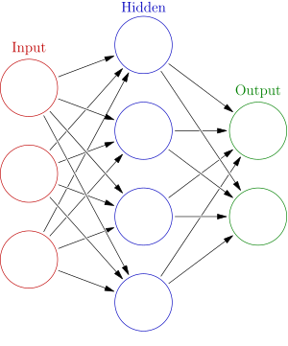
Neural = bundle of perceptron

Slide 7
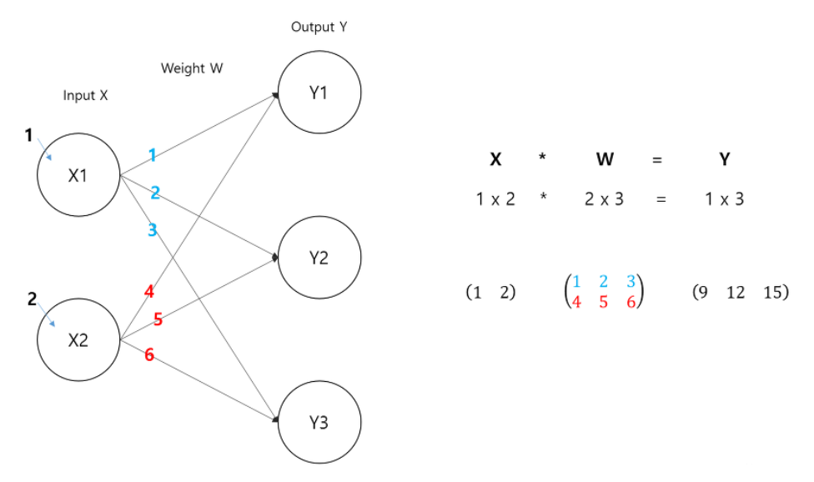
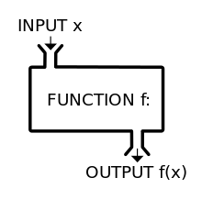
Activation?

Slide 8
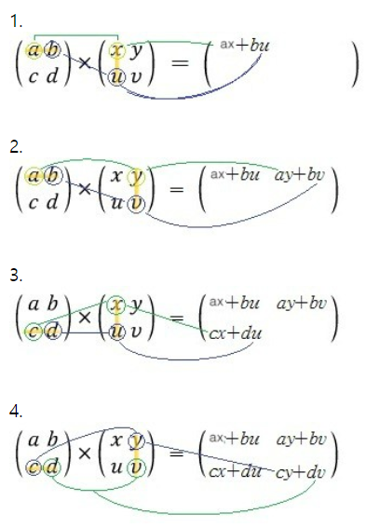
Matrix calculation

Slide 9
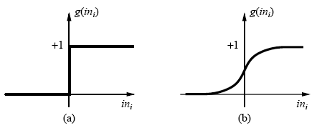
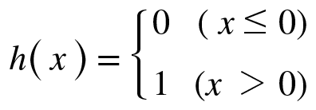
Step function

Slide 10
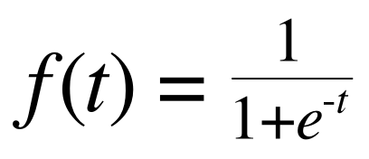
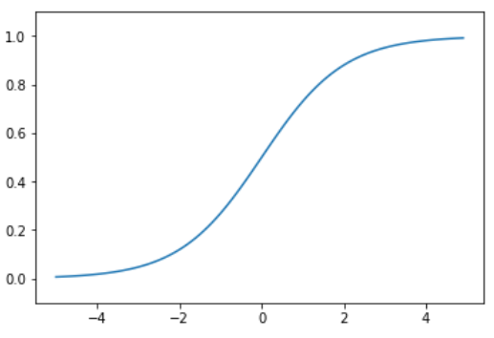
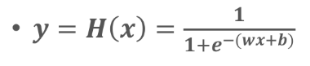
sigmoid

Slide 11
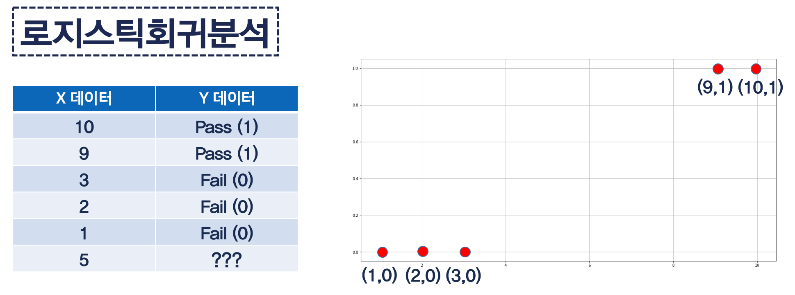
Sigmoid

Slide 12
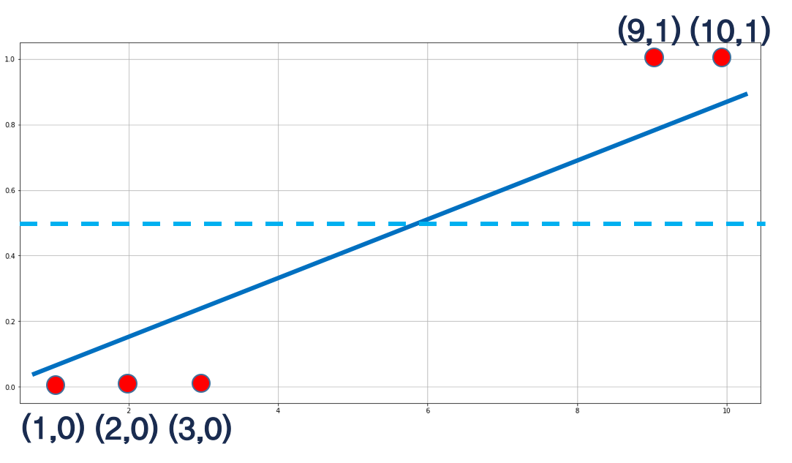
Sigmoid

Slide 13
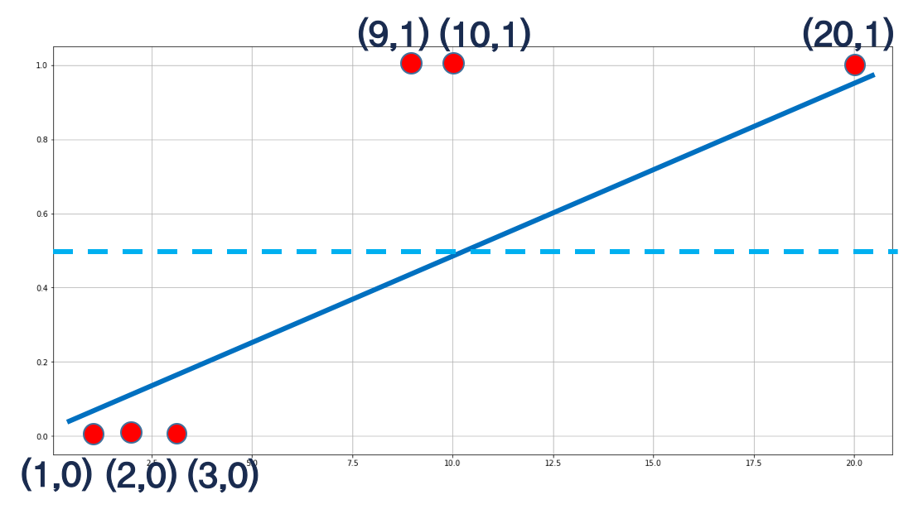
Sigmoid

Slide 14
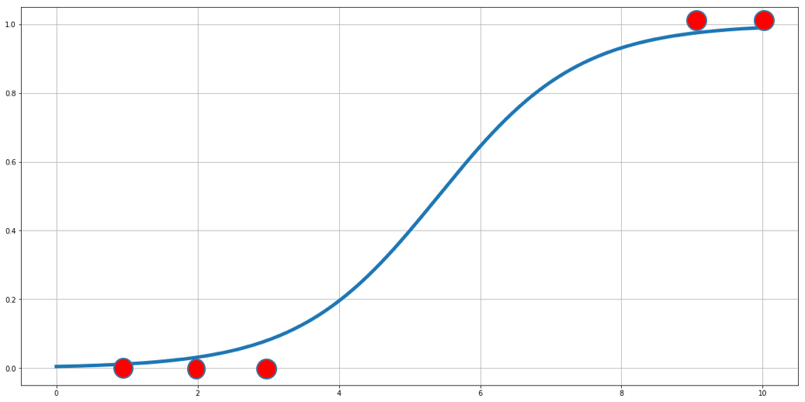
Sigmoid

Slide 15
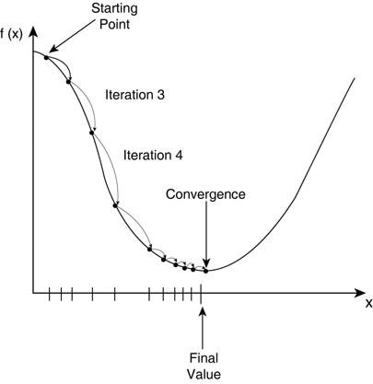
Gradient descent

Slide 16
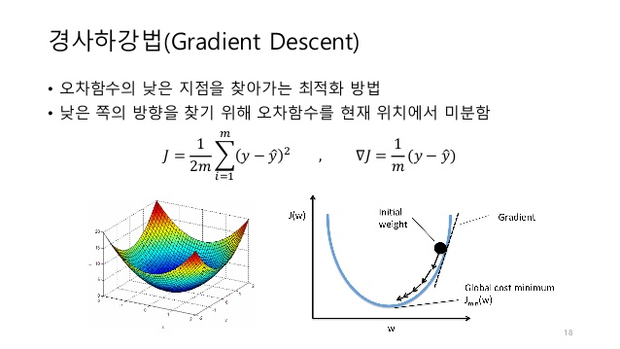
Gradient descent

Slide 17
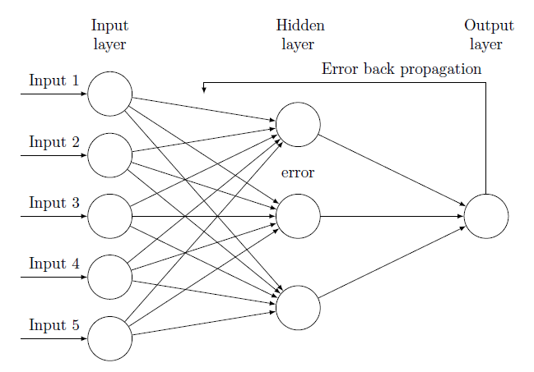
Error back propagation

Slide 18
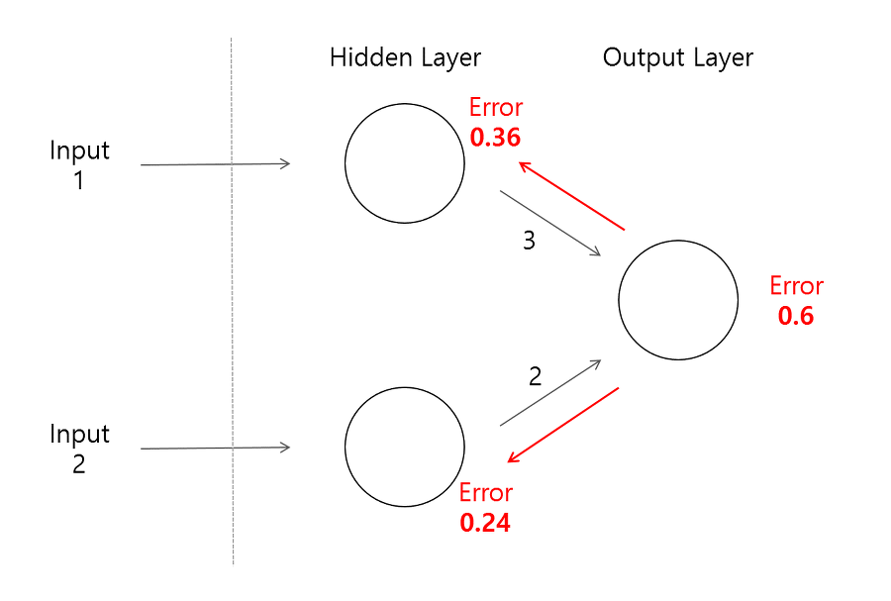
Error back propagation example

Slide 19
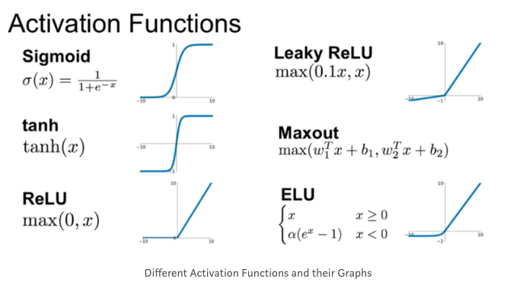
Activation functions

Slide 20
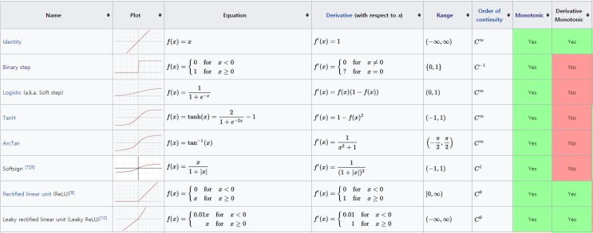
Activation

Slide 21
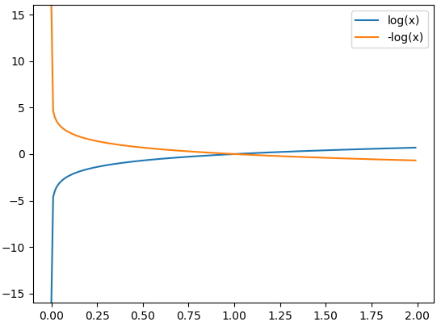
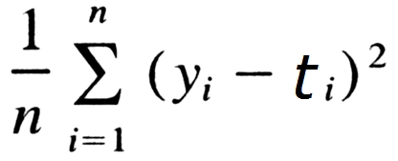
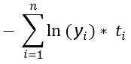
Loss function
Mean Squared Error
Cross Entropy Error

Slide 22
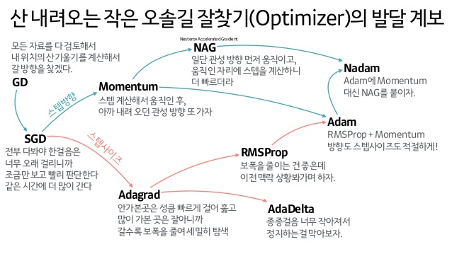
optimizer

Slide 23
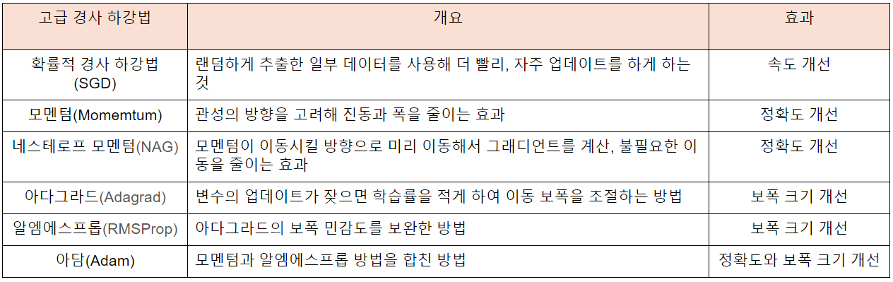
Gradient Descent Algorithms.

Slide 24
Train / test / validation set
Train set
Studied prior examination
Test set
Non-Studied prior examination
Validation
Is it right way?

Slide 25
Epoch / batch
Epoch
How many times will study data?
Batch
How many data will be study on single time?

Slide 26
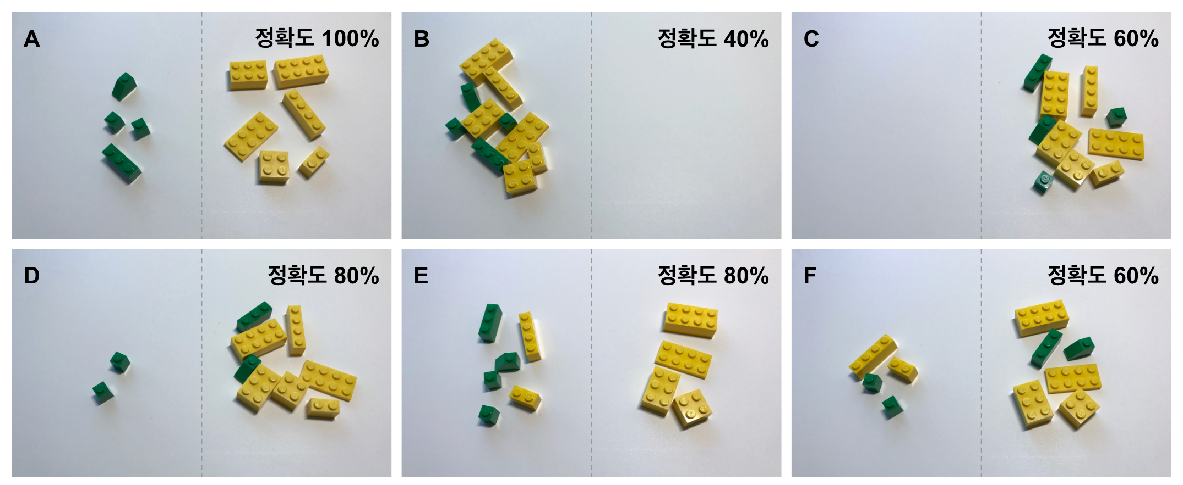
accuracy
(TP + TN / TP + FN + FP + TN)

Slide 27
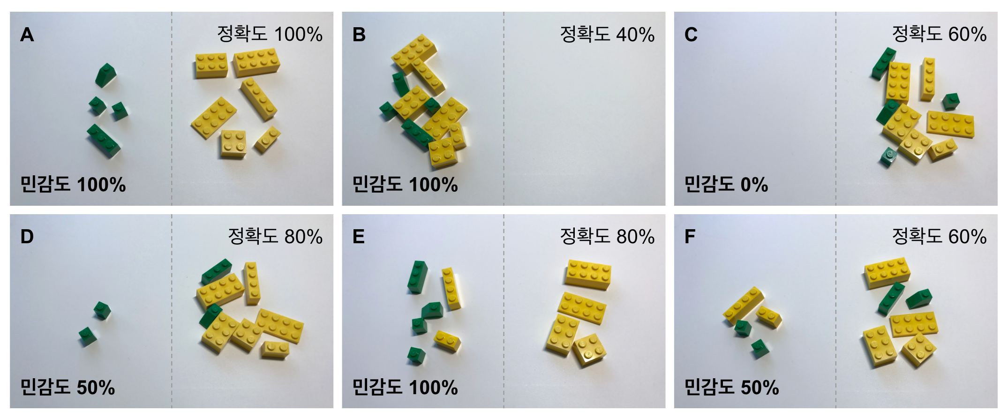
Sensitivity
(TP / TP + FN)

Slide 28
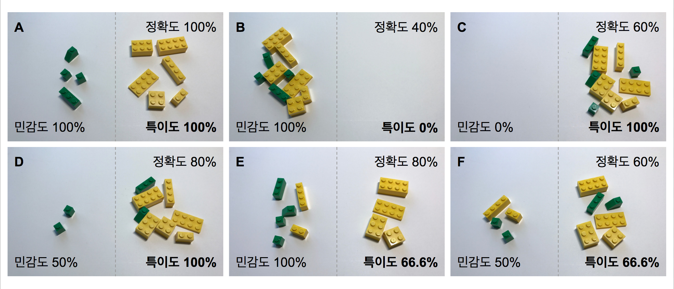
Specificity
(TN / FP + TN)

Slide 29
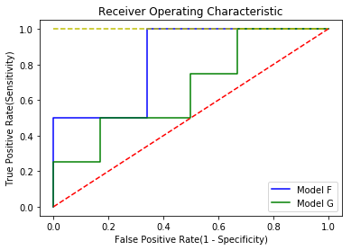
ROC
-> AUC(Area Under Curve)
= scale area for ROC
Sensitivity, Specificity

Slide 30
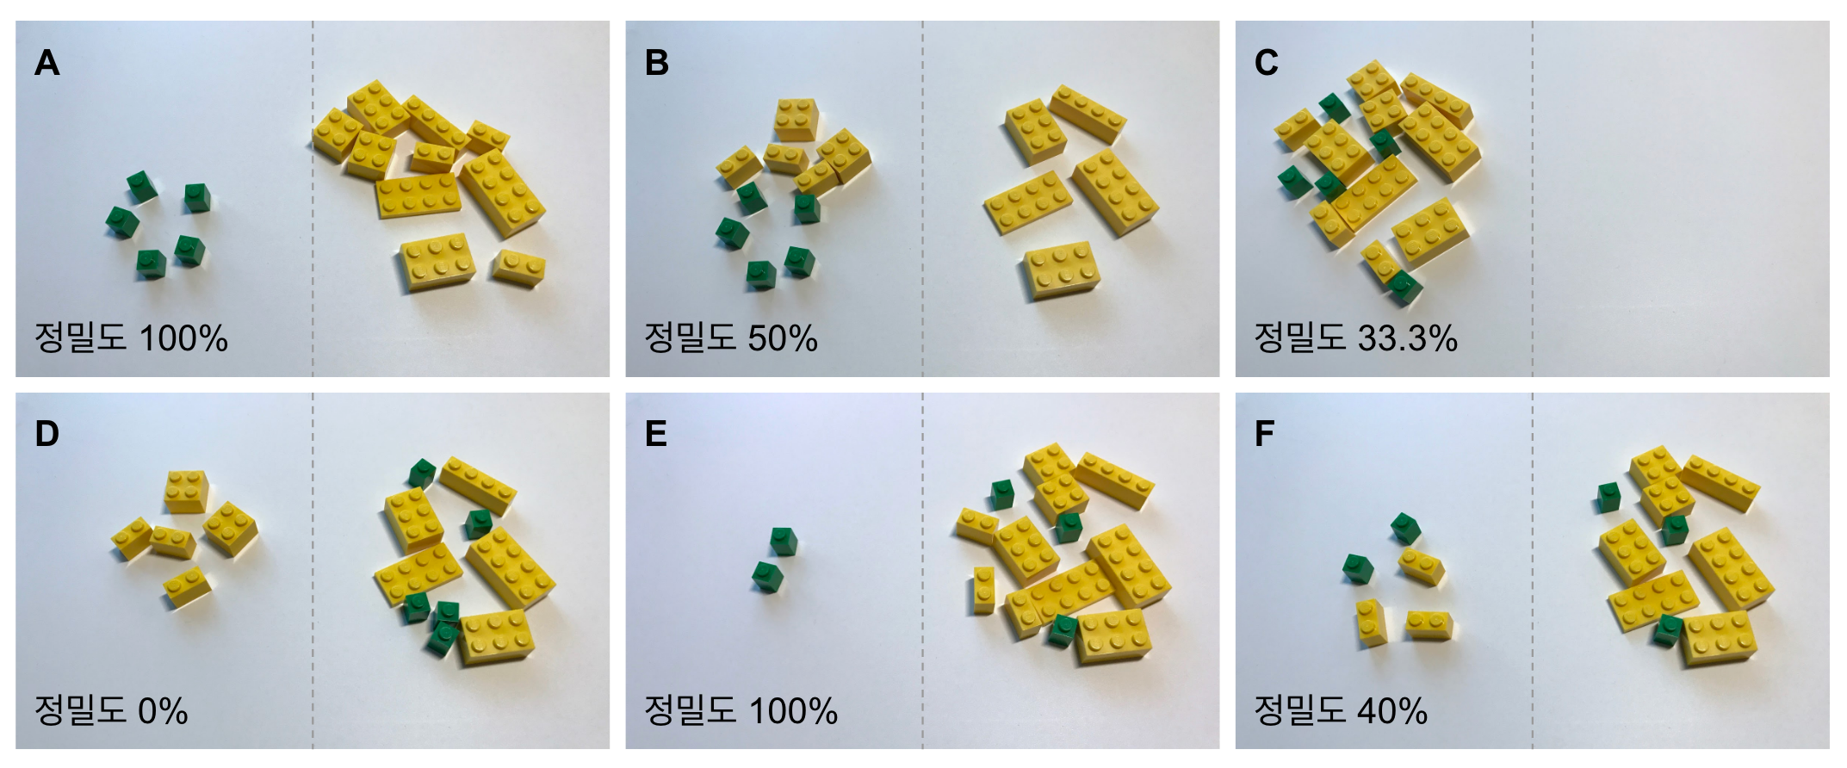
Precision
(TP / TP + FP)

Slide 31
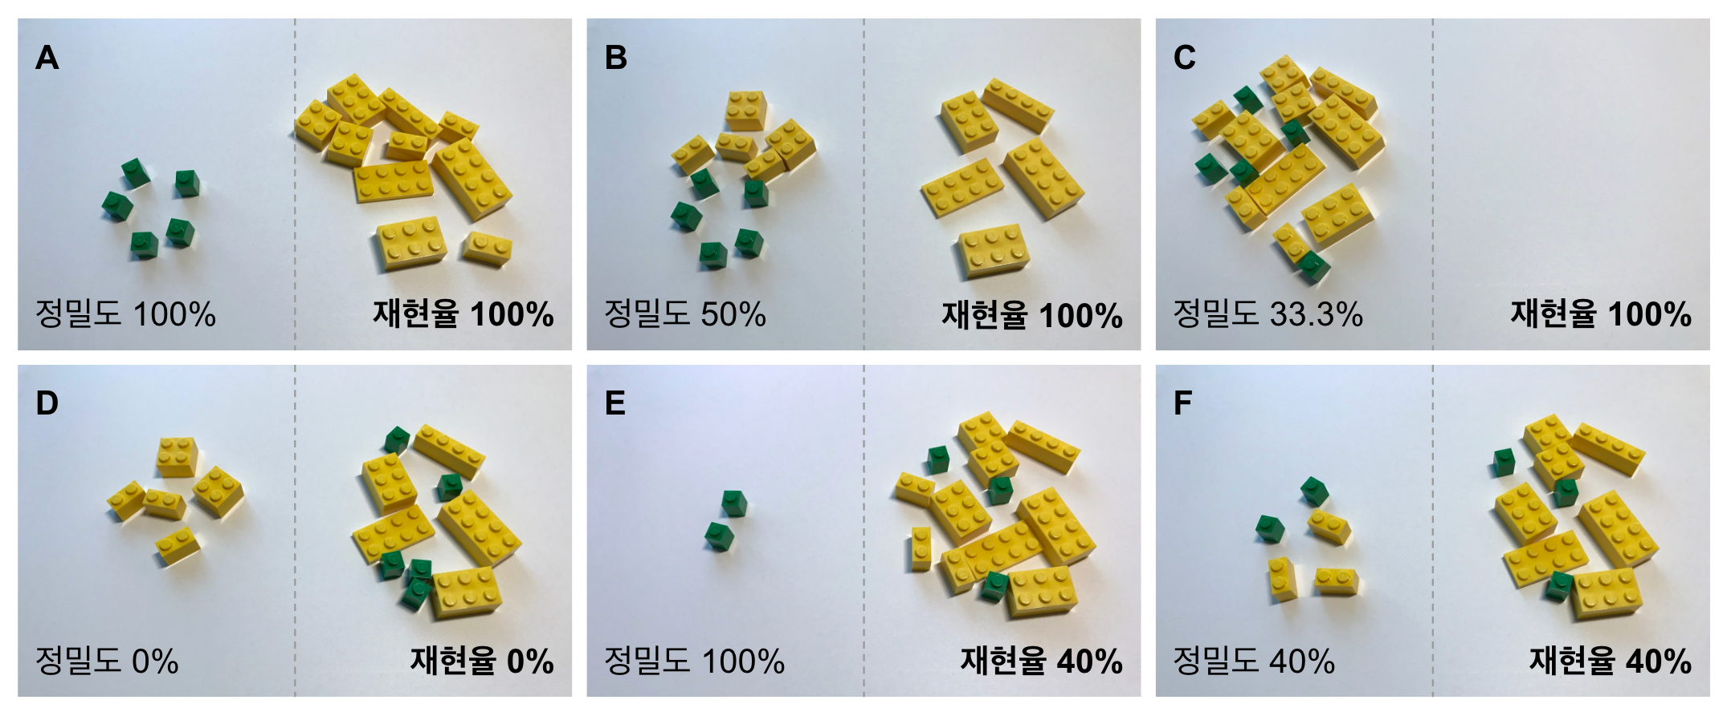
Recall
(TP / TP + FN)

Slide 32
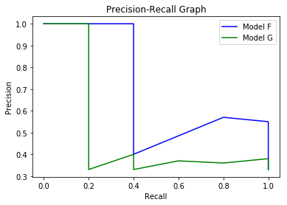
AP(Average Precision)

